Slide 1
HHCS EVV Town Hall
Tuesday, February 21, 2023
2:00p – 3:00p CST

Slide 2
Discussion Topics
Welcome and Town Hall Guidelines
Federal and State Electronic Visit Verification (EVV) Requirements
Provider Process
Integration Testing Process
EVV Vendor Specification and JSON
Common EVV Vendor Support Issues (Errors and troubleshooting steps)
Support Contact Information (Required information to help triage issues)
EVV Vendor and Provider Support Resources
Coming Soon (Town Hall #2 and Town Hall #3)

Slide 3
Welcome and Town Hall Guidelines
Purpose:
Announce the opening of the provider online registration and provide vendor specification for HHCS.
Guidelines:
All participants have been placed on mute.
Post presentation specific questions using the Q&A feature. Questions will be answered during the presentation as time permits.
Sandata will be distributing a survey to collect feedback. Participation is encouraged.
Notes:
If we don’t get through the questions during the town hall, we can state we will address them via another form of communication

Slide 4
Federal and State EVV Requirements

Slide 5
21st Century Cures Act Requirements
The 21st Century Cures Act, passed in 2016, directs States to require the use of an EVV system for Medicaid funded Personal Care Services (PCS) and Home Health Care Services (HHCS).
The Cures Act requires that EVV systems capture the following six data elements:
Member receiving the services
Caregiver providing the service
Type of service
Location of the service delivery
Date & time the service begins
Date & time the service ends

Slide 6
Missouri Specific Requirements
To meet the obligations of the Cures Act, Missouri requires the use of the following client and employee identifiers:
Departmental Client Number (DCN)-the 8-digit identifier for the client
Client Date of Birth (DOB)-is used for dual authentication
Family Care Safety Registry (FCSR)-the 8-digit identifier for the employee

Slide 7
Home Health Care Services Requiring EVV
EVV is required to document delivery of the following types of services:
Nursing (RN/LPN)
Occupational Therapy
Physical Therapy
Personal Care Aide
Speech Therapy
Any of the above services reimbursed by a Managed Care Organization (MCO)
Additional details regarding the service delivery can be documented in the Memo field.

Slide 8
Provider Process

Slide 9
Step 1-Registration
HHCS providers register their EVV vendor with Sandata
Registration Link
Required information:
9-digit Medicaid Provider ID. For HHCS this number begins with a 58
This form must be completed for each Medicaid Provider ID.
10-digit National Provider Identifier (NPI)
EVV Vendor and Contact Information
Providers must complete this form for every EVV vendor the agency contracts with.
Providers will receive a confirmation email upon registration completion.
For help with the Medicaid Provider ID, contact Missouri Medicaid Audit & Compliance (MMAC) at MMAC.EVV@dss.mo.gov . Include the provider NPI when contacting MMAC.
Notes:
A PCS and HHCS provider that has already registered their EVV vendor for PCS services, must complete this form to register their EVV vendor for HHCS services.

Slide 10
Step 2-EAS Training
EAS training provides instruction on how to access and navigate EAS as well as how to verify your data is being transmitted by your EVV vendor.
At least one member of your agency must complete EAS training prior to the release of your EAS login information.
The online training is free, self-paced and takes approximately 15 - 30 minutes to complete.
Print and save a copy of your training completion certificate for your records.
Additional training information is available Provider Supplemental Training.

Slide 11
Step 3-Go Live
The EVV vendor must successfully pass integration testing before the vendor can submit data to EAS on the provider’s behalf.
Login information is issued to provider
Login information is issued to EVV vendor
EVV vendor submits provider visit data to EAS
Communication between the provider and EVV vendor is critical to integration success.

Slide 12
Step 4-Data Verification
Providers are responsible for logging in to EAS to ensure visit data is being submitted by their EVV vendor and the visit data is correct.
Providers and EVV vendors should submit visit data at a minimum of once a day.
Providers must communicate frequently with their EVV vendors to ensure their visit data is being sent to EAS.

Slide 13
Integration Testing Process

Slide 14
Integration Details
Member Matching
Testing: A match on Client DCN and Date of Birth will occur on 6 member records loaded to each test account. Data will be supplied to the vendor when credentials are sent.
Production: A match will be done on Client DCN and Date of Birth sent by the EVV vendor to the Client DCN and Date of Birth provided by the State system.
No DCN match will result in the client record being rejected.
No Date of Birth match will result in the client record being rejected.
A successful DCN match and Date of Birth match will result in the record being added to the provider account (distinct 9-digit ProviderID).
To align with production requirements during testing, EVV vendors will submit a daily member file with all updates.

Slide 15
Integration Testing
Certification Testing Checklist
EVV vendors with multiple providers only need to certify one time for all providers.
Testing Complete?
Submit completed checklist to Sandata at moaltevv@sandata.com.
Sandata will validate the testing checklist.
If an EVV vendor passes, they will be issued production credentials for all associated provider agencies and be added to the certified list of MO DSS vendors.
If an EVV vendors fails the validation of their testing checklist, Sandata will supply feedback on what needs to be corrected before the checklist is resubmitted.
Certification of EVV vendors.
Distribution of credentials.
Providers – access to EAS.
EVV vendors – production credentials.

Slide 16
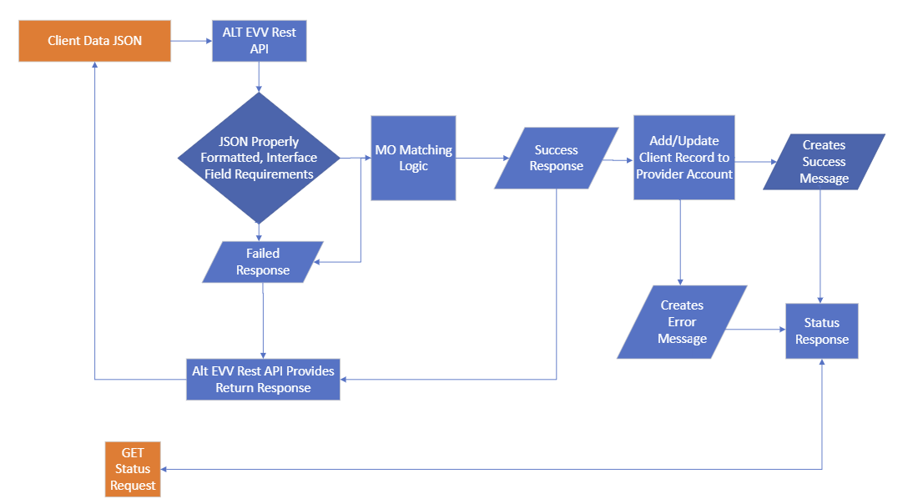
Client Flowchart

Slide 17
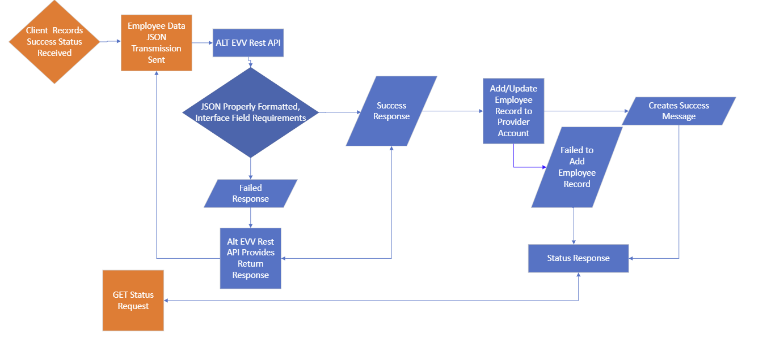
Employee Flowchart

Slide 18
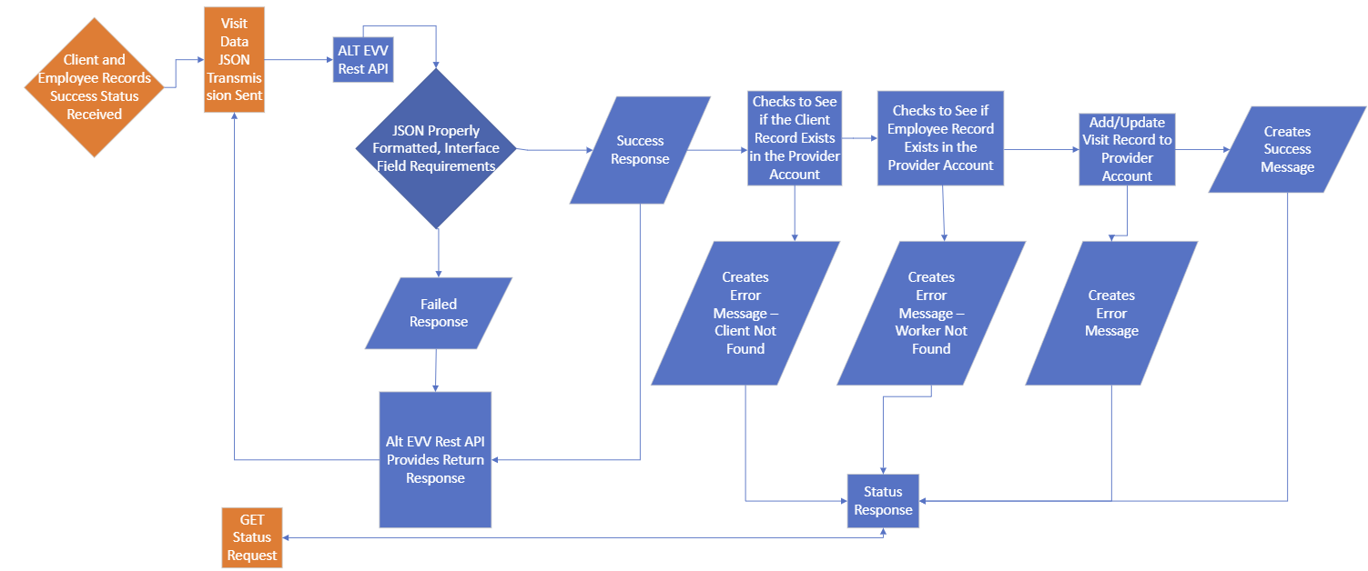
Visit Flowchart

Slide 19
Integration Questions
End Points:
https://uat-api.sandata.com – End point used for testing and completion of checklist.
https://api.sandata.com – End point used for “live” production data.
In the BillVisit field of Visit record, validation rule mentions, String match = "True". Does that mean we always have to send True for this field? If so, how should we mark a visit as deleted or omitted?
BillVisit when set to true will mark visit data ready for payment (verified). BillVisit set to false, will mark the field as OMIT in the EAS system and will not be included for claims matching.
When will Sandata accept testing data?
Effective Monday, March 6, 2023.

Slide 20
EVV Vendor Specification and JSON

Slide 21
Understanding the EVV Vendor Specification
The EVV vendor specification and user guide are housed on the Missouri EVV website.
EVV vendor specification: https://dss.mo.gov/mhd/providers/pdf/evv-vendor-specification.pdf
Specification user guide: https://dss.mo.gov/mhd/providers/pdf/specification-user-guide.pdf
The EVV vendor specification contains three sections:
Client
Employee
Visit

Slide 22
Client Overview
Three Segments for client records:
Client General – Required
Client Address – Required
Client Phone – Recommended
Client payer segments are not required and should not be sent.
Identifiers are used for matching logic:
ProviderID value: 9-Digits Medicaid ID
ClientBirthDate: YYYY-MM-DD (Required)
ClientIdentifier: 8-Digits exactly including leading zeros Departmental Client Number (DCN)
Error Message: “Client_ID Not Found” will post if an initial match with the MMIS ClientIdentifier loaded to Sandata is not made.
EVV vendors may need to resubmit after 24 hours to obtain ClientIdentifier match.
Client Validation:
ClientIdentifier and ClientBirthDate match to State MMIS data.
ClientAddress segment is required
ClientPhone segment is recommended

Slide 23
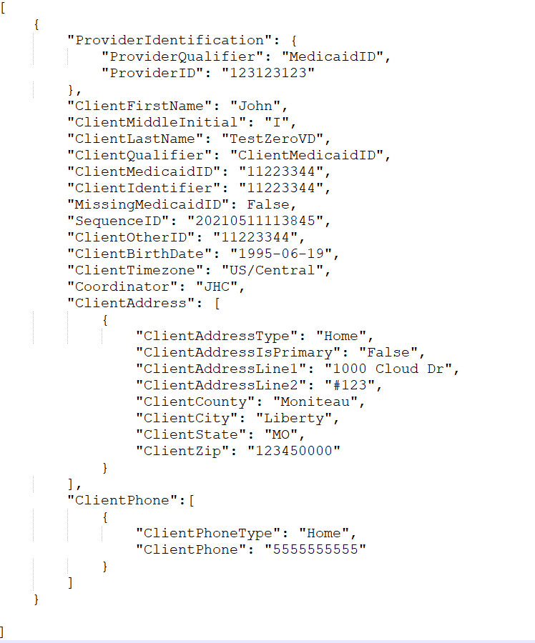
Client Overview: JSON
EVV vendor data is sent via RESTful API / JSON transmissions
Example: Missouri Client API

Slide 24
Employee Overview
One required segment for Employee (Person providing service in the home):
Employee General
Identifiers used for matching logic:
ProviderID value: 9-Digits Medicaid ID
EmployeeIdentifier: 8-Digits exactly including leading zeros Family Care Safety Registry (FCSR) Number
Employee Validation:
EmployeeIdentifier length check
EmployeeIdentifier will be matched to existing records:
No Match = Insert new record
Yes Match = Update existing

Slide 25
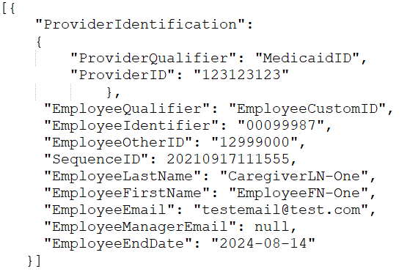
Employee Overview: JSON
EVV vendor data is sent via RESTful API / JSON transmissions
Example: Missouri Employee API

Slide 26
Visit Overview
One required segment for Visit Records:
Visit General
Three conditional segments for Visit Records:
Calls
Visit Changes
Visit Tasks
Identifiers used for matching logic:
ProviderID value: 9-Digits Medicaid ID
VisitOtherID value: ID from EVV vendor system
ClientIdentifier: 8-Digits Departmental Client Number (DCN)
EmployeeIdentifier: 8-Digits Family Care Safety Registry (FCSR) Number

Slide 27
Visit Overview
Procedure code validation.
PayerID, PayerProgram, & ProcedureCode must match to a valid record as listed in the specification.
ClientIdentifier must match to existing client record.
Error Message: “Client_ID Not Found” will post if an initial match with the MMIS ClientIdentifier loaded to Sandata is not made.
EVV vendors may need to resubmit after 24 hours to obtain ClientIdentifier match.
EmployeeIdentifier must match to existing employee record.
Optional segments are required based on the condition for the segment.
Example: When a change is required for a visit previously sent to the EAS, the updated visit will require the VisitChange Segment.
Visits performed without electronic call data (manual calls) will require the ‘VisitChanges’ segment to be included in the ‘Visit’ transmission.

Slide 28
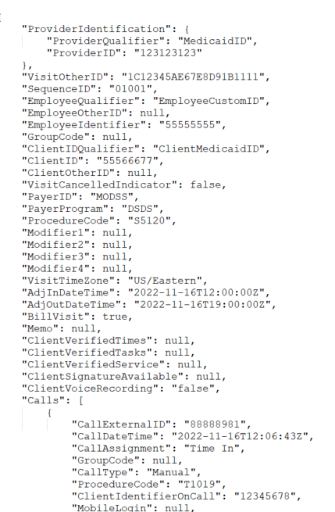
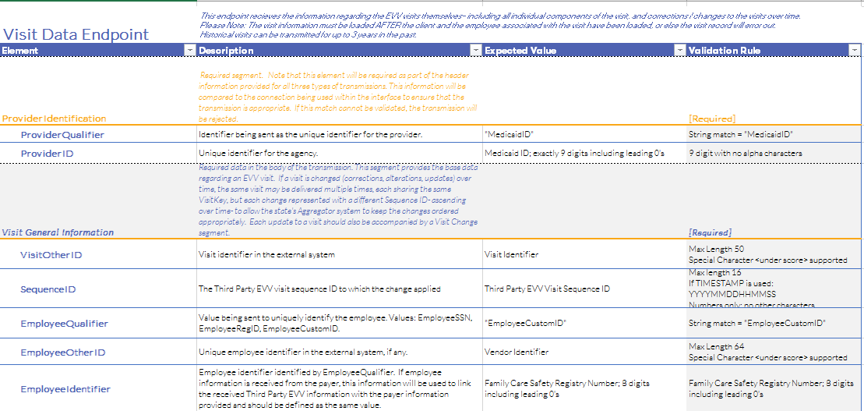
Visit Overview: JSON
EVV vendor data is sent via RESTful API / JSON transmissions
Example: Missouri Visit API

Slide 29
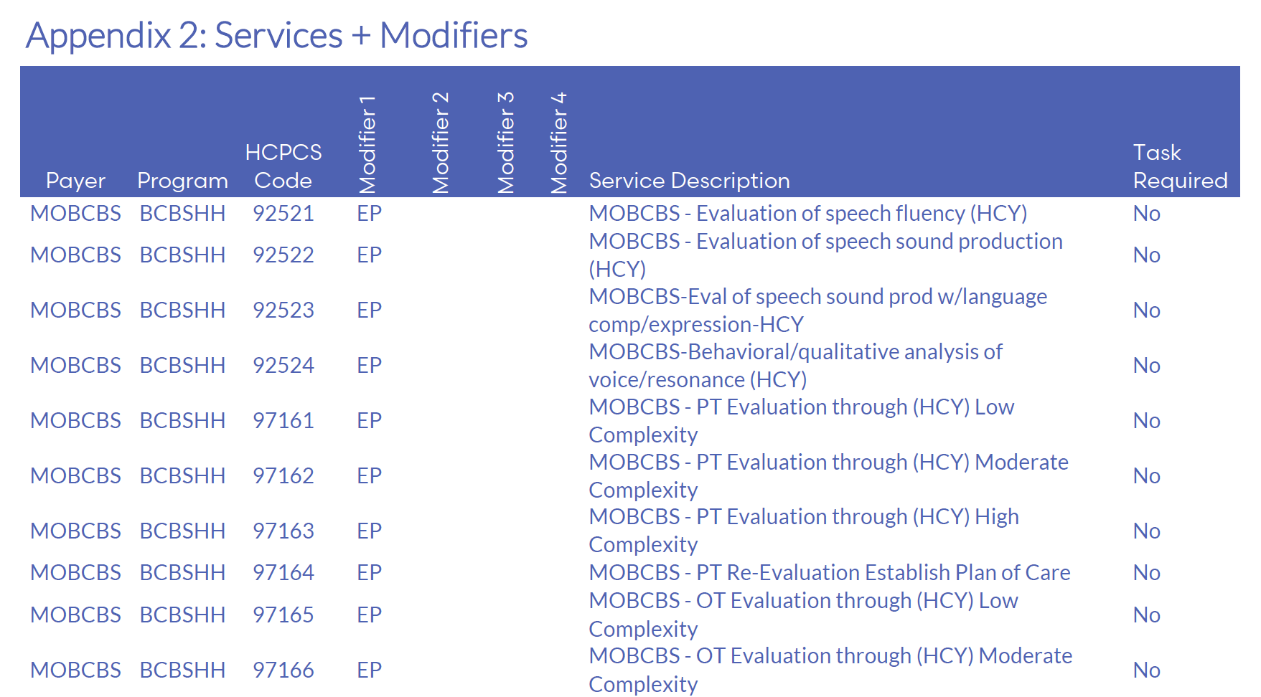
Services and Modifiers – Sample of Appendix 2

Slide 30
Visit Exceptions
Exceptions ensure data aligns to program definition for the Missouri EAS program.
The Missouri exceptions will cause incomplete visit status; and therefore, are not acknowledgeable via the API.
On error, correct the missing or incorrect data and resubmit the transaction.
For Missing Task Exception, Exception Code 10, tasks are required for some services and if the visit does not include a task, the visit will be set to incomplete. (This exception only applies to personal care services.)
Exception Code | Exception Name
0 | Unknown Clients
1 | Unknown Employees
2 | Visits Without Any Calls
3 | Visits Without In-Calls
4 | Visits Without Out-Calls
10 | Missing Task Exception *
23 | Missing Service

Slide 31
Common EVV Vendor Support Issues

Slide 32
Common EVV Vendor Support Issues
Invalid Credentials
Error Message: Error Message: “Request contains the following providers that are not authorized for the given Account & Credentials: [ProviderID]”.
Root Cause:
Provider does not have valid credentials.
What can we do to troubleshoot?
Contact Sandata at:
MOAltEVV@Sandata.com
1-833-350-5844

Slide 33
Common EVV Vendor Support Issues
Client Not Found – Error Code -1021 (Client Record)
Error Message: “Client_ID Not Found”
Root Cause 1:
Client does not exist in provider account.
Client JSON failed to be created.
Transmission of visit data with not correctly formatted Client Identifier – format requires leading 0s and must be exactly 8 digits.
Client does not exist in State-provided client/member file feed.
Error Message: “Client_ID Not Found” will post if an initial match with the MMIS ClientIdentifier and ClientBirthDate loaded to Sandata is not made.
EVV vendors may need to resubmit after 24 hours to obtain ClientIdentifier match.
What can we do to troubleshoot?
Check EAS to ensure Client record was successfully added to the provider account.
Access the eMOMED portal (eligibility and billing) to check member dates of birth.
Check the EVV vendor specification for the format and ensure the correct value is in the correct field.
Ensure Visit Client Identifier matches Client Identifier on Client record.
MOAltEVV@Sandata.com
1-833-350-5844
If failed on weekly resubmit, contact the State for support.

Slide 34
Common EVV Vendor Support Issues
Worker Not Found – Error Code -1031 (Visit Record)
Error Message: “Worker_ID Not Found”
Root Cause 1:
Employee not properly specified.
Employee Identifier is not correctly formatted. For example: the Payer program may require an ID that is padded with leading zeroes.
Improper transmission format where a valid Employee Identifier is in the wrong JSON field.
What can we do to troubleshoot?
Check the EVV vendor specification for the format and ensure the correct value in the correct field.
Possible Next Steps:
May need to involve Sandata EVV vendor support for additional troubleshooting.
MOAltEVV@Sandata.com
1-833-350-5844
Retransmit Employee data to EAS.

Slide 35
Common EVV Vendor Support Issues
Service ID – Error Code -553 (Visit Record)
Error Message: “Error during retrieving service service_id entered”.
Root Cause 1:
Missing service in visit.
All visits must include the service provided to the member to be verified.
What can we do to troubleshoot?
Check the EVV vendor specification for the valid service, if applicable, modifier field combinations and order to ensure the provider has the correctly formatted value in the correct field.
Possible Next Steps:
May require investigation of service code and visit processing with Sandata’s Engineering team.
MOAltEVV@Sandata.com
1-833-350-5844
Retransmit with corrected visit data to EAS.

Slide 36
Common EVV Vendor Support Issues
Service ID – Error Code -553 (Visit Record)
Error Message: “Error during retrieving service service_id entered”
Root Cause 2:
Incorrectly formatted service in visit.
All services and modifiers are case sensitive and must use capital letters.
For example: t1019 hq ha is a valid service code with modifiers will fail due to the lower-case letters.
All services and modifiers must be provided in the proper sequence/order.
For example: If T1019 HQ HA is a valid service code with modifiers then a visit submitted as T1019 HA HQ is an invalid combination of modifiers for visit verification.
What can we do to troubleshoot?
Check the EVV vendor specification for the valid service, if applicable, modifier field combinations and order to ensure the provider has the correctly formatted value in the correct field.
Possible Next Steps:
May require additional investigation of service code and visit processing with Sandata’s Engineering team
MOAltEVV@Sandata.com
1-833-350-5844
Retransmit with corrected visit data to EAS.

Slide 37
Integration Best Practices
Send Client (Member) Records First.
Send all Clients as soon as possible.
Check status to ensure Client loaded successfully.
Send Employee (Caregiver) Records Second.
Send all Caregivers as soon as possible.
Check status to ensure Employee loaded successfully.
Send Visits after verifying that Clients and Employees have loaded successfully.
Continue to send visits at a minimum, once daily in alignment to the Missouri DSS requirement.
Send new clients as they are identified, or an existing record is updated.
Send new employees as they are identified, or an existing record is updated.

Slide 38
Working with Sandata Customer Support
The following information will be collected by our support team to help expedite resolution of your case:
Provider name
EAS account number (referred to as your STX #)
Provider contact name
EVV vendor contact information
Vendor contact email address
Vendor contact direct phone
Description of issue
Please provide a brief description of the issue and when it started.
Please include:
Screenshots
JSON files
UUIDs
IMPORTANT: JSONs and screenshots should be sent securely and are required to investigate any errors received during transmission (e.g., Client Not Found).

Slide 39
EVV Support Resources
Sandata MO DSS EVV Vendor Support:
Email: moaltevv@sandata.com
Phone: 1-833-350-5844
Missouri EVV Website:
Resources for the EVV vendors
Link for EVV vendors: https://dss.mo.gov/mhd/providers/electronic-visit-verification.htm

Slide 40
Coming Soon
EVV HHCS Town Hall #2
Focus: Delivery of Testing Credentials
Date: Monday, March 6, 2023
Time: 2:00p – 3:00p CST
Registration link will also be distributed via formal communication and posted on the MO DSS EVV vendor-specific webpage.
Sandata Town Hall #2 Registration Link
EVV HHCS Town Hall #3
Focus: System Soft Launch
Date: Wednesday, May 17, 2023
Time: 9:30a to 10:30a CST
Registration link will also be distributed via formal communication and posted on the MO DSS EVV vendor-specific webpage.
Sandata Town Hall #3 Registration Link

Slide 41
Thank You!

